Slide 1
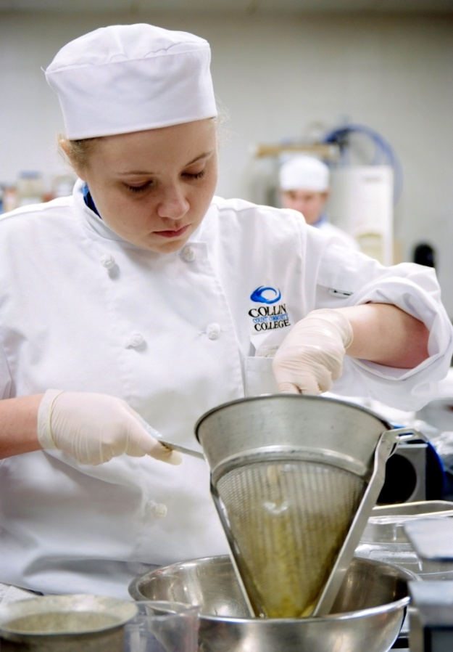
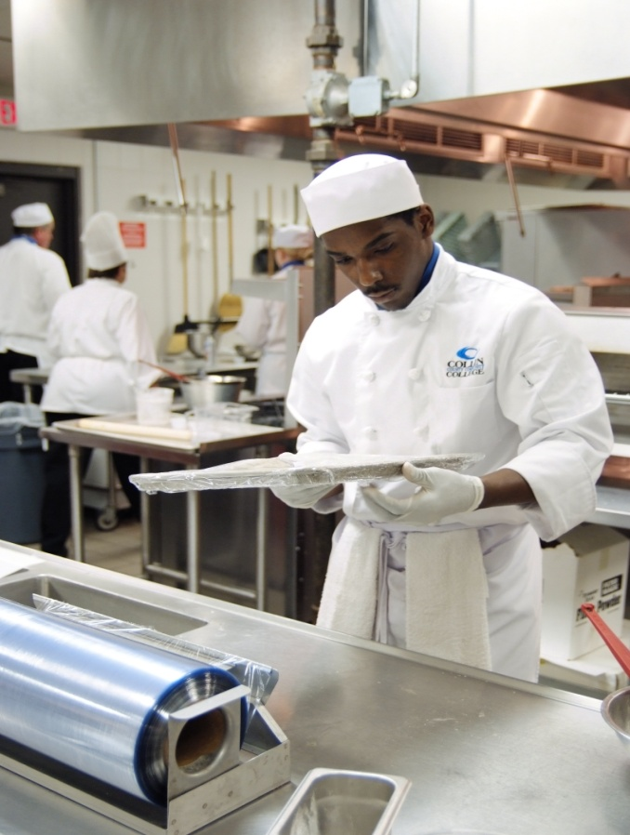
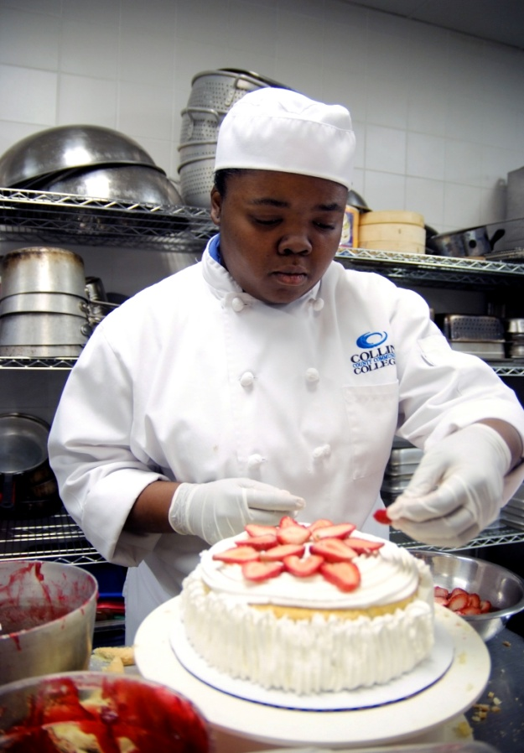
Welcome to Collin’s Culinary & Pastry Arts Student Orientation Revised: Oct 2024

Slide 2
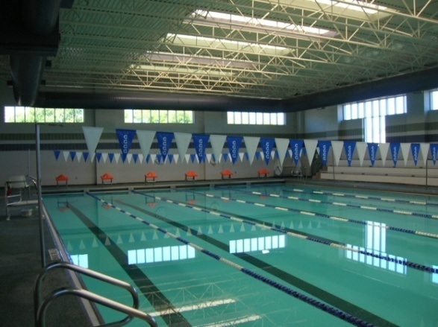
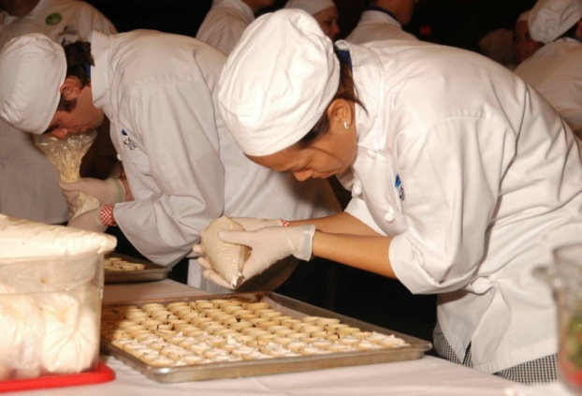
Program History
Lodging Mgmt.- 1997
Culinary Arts AAS- 1999
Pastry Arts AAS- 2009
ACF/ACPHA Accredited in 2016

Slide 3
IHCE Mission Statement
The Institute of Hospitality & Culinary Education (IHCE) prepares students for the demands of the fast-paced hospitality and foodservice industry.
We are committed to developing skills, strengthening character, work ethic, and challenging the student’s intellectual and creative curiosity.

Slide 4
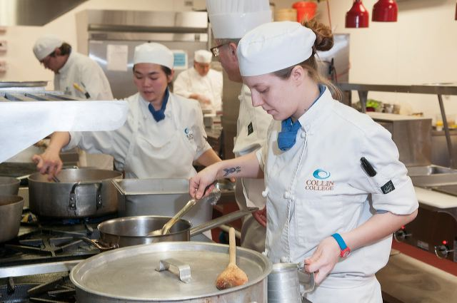
IHCE Program
AAS Degree Programs
Culinary Arts
Associate of Applied Science (AAS) Degree
60 credit hours
Pastry Arts
Associate of Applied Science (AAS) Degree
60 credit hours

Slide 5
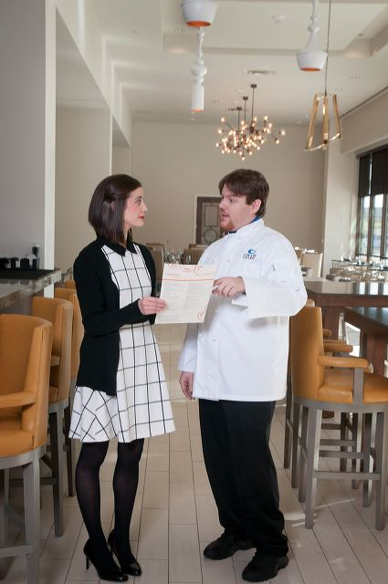
Certificate Programs:
IHCE Culinary/Pastry Program
Culinary Arts Certificate
24 credit hours
Pastry Arts Certificate
24 credit hours

Slide 6
Cost of Degrees
AAS Culinary Arts – 60 credit hours
In County - Culinary Arts AAS Total: | $5,135 ($86/credit hour)
Out of County - Culinary Arts AAS Total: | $7,595 ($126/credit hour)
Out of State - Culinary Arts AAS Total: | $11,195 ($187/credit hour)
AAS Pastry Arts- 60 credit hours
In County - Pastry Arts AAS Total: | $5,260 ($88/credit hour)
Out of County - Pastry Arts AAS Total: | $7,720 ($129/credit hour)
Out of State - Pastry Arts AAS Total: | $11,320 ($189/credit hour)

Slide 7
Cost of Certificates
Certificate- Culinary Arts – 24 credit hours
In County - Culinary Arts Cert. Total: | $2,249 ($94/credit hour)
Out of County - Culinary Arts Cert. Total: | $3,233 ($135/credit hour)
Out of State - Culinary Arts Cert. Total: | $4,673/$195/credit hour)
Certificate- Pastry Arts- 24 credit hours
In County - Pastry Arts Cert. Total: | $2,469 ($103/credit hour)
Out of County - Pastry Arts Cert. Total: | $3,453 ($144/credit hour)
Out of State - Pastry Arts Cert. Total: | $4,893 ($204/credit hour)

Slide 8
ACF Accredited Program
AAS Culinary Arts = CC (certified culinarian)
AAS Pastry Arts = CPC (certified pastry culinarian)
Active ACF membership $50.00/year Student Membership
Collin College will submit transcripts directly to ACF after your AAS graduation for 1-year membership and 5-year CC or CPC certification.
Applications are completed at your capstone course,
CHEF1314/RSTO1304 or PSTR2331

Slide 9
Sample of Transfer Universities
1. Texas Womans University
2. University of Houston
3. Business and Hotel Management School Switzerland
4. Texas Tech
5. University of North Texas
Tarleton State University (Member of the Texas A & M University System)
7. Texas A& M University Commerce

Slide 10
Culinary/Pastry Faculty
Chef Jill McCord
Professor of Pastry Arts
B.S. Health Education
- Eastern Illinois University, Illinois
A.S. International Baking & Pastry
- Florida Culinary Institute, Florida
Office: PRC - A162
Phone: 972-377-1057
JMcCord@collin.edu

Slide 11
Culinary/Pastry Faculty
Chef Andrew Jardim, CEC
Professor of Culinary Arts
A.O.S. Culinary Arts
-Culinary Institute of America
ACF Certified Executive Chef (CEC)
Office: PRC - A164
Phone: 972-377-1752
ajardim@collin.edu

Slide 12
Culinary/Pastry Faculty
Chef Ronald Reczek
Professor of Culinary Arts / Discipline Lead
A.O.S. Culinary Arts
- Johnson & Wales University
B.S. Food Service Management
- Johnson & Wales University
MBA Master of Business Administration
- Texas A&M University
Office: PRC - A163
Phone: 972-377-1773
RReczek@collin.edu

Slide 13
Culinary/ Pastry Staff
Culinary Lab Coordinator
Lauren Jones (Martinez)
Office: PRC - A154
Phone: 972-377-1068
lmartinez@collin.edu
Culinary Lab Assistant
Reldon Caddy
Office: PRC- A155
Phone: 972-377-1084

Slide 14
Culinary/ Pastry Staff
P/T Storeroom Clerk- Alex
- Maintains kitchen labs and storeroom
P/T Culinary Steward- Ken Holland
- Maintains kitchen equipment and kitchen labs

Slide 15
Your Program Career Coach
Mr. John Hines
Workforce Programs Career Coach
Office: PRC- H-210C
Phone: 972 -377-1733
JHines@collin.edu

Slide 16
Registration questions ??
After attending a Culinary/Pastry orientation you will be granted a permit override for the upcoming semester for CHEF1301 and PSTR1301 courses.
This orientation is the only way receive a permit override.
Registration assistance or to clear holds---Please contact jhines@collin.edu
Collin College class registration link:
https://www.collin.edu/gettingstarted/register/registration.html

Slide 17
How Our Lab Class Schedule Works
EXPRESS CLASS FORMAT
Kitchen Lab Courses are 8 weeks long.
The classes meet 2X a week
Each lab class is approximately 5 hours long.
There are morning, mid-day, and evening classes. Mon-Thurs, AM have the most class offerings.

Slide 18
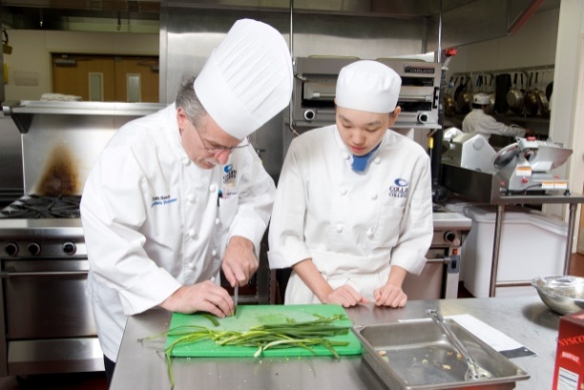
Outline of Typical Culinary/ Pastry Arts Class
Student arrives to lecture on time and having check their cougar email account & course CANVAS access
Students must be in full uniform in all kitchen lab classes
Be prepared to start class with:
Notebook
Class Textbook(s)
4x6 index recipe cards or recipe book
Pocket notebook
Pen/pencil/black Sharpie marker
Class handouts
Handheld Calculator (Not a cell phone)

Slide 19
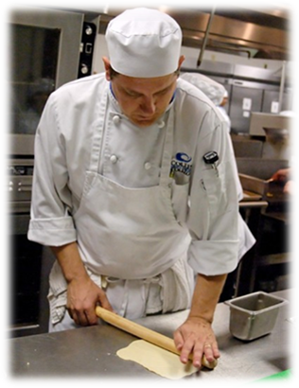
Outline of Typical Culinary/ Pastry Arts Class
Hands on cooking/baking lab in either:
A151 - Advanced Food Prep Kitchen
A152 – Basic Skills Kitchen
A153 - Baking and Pastry Kitchen
-Food tasting & critique
Kitchen clean up

Slide 20
Required Supplies for all Kitchen Lab Classes (includes first class day)
1. Complete Culinary/Pastry Arts Uniform
2. Tool Kits and Course Required Supplies
3. Course Required Textbooks

Slide 21
1. Full Uniform
"A Chef's professional pride can be extended to personal appearance and behavior in and around the kitchen"
IMPORTANT: You must be in full uniform the first day of CHEF 1301, PSTR 1301, RSTO 2307 lab class.
Neckerchief
(color depends on major)
Chef Beanie Hat, No Ear or Facial Jewelry
Pressed Collin Logo Chef Coat with, Digital Thermometer, Sharpie & 6" Stainless Ruler
Nothing on Wrists or Hands, Only a Wedding Band
Pressed Plain Black Pants
White Side Towels
Black Non-slip soled shoes with black or white socks
White Apron

Slide 22
1. Full Uniform continued…
Face masks are optional for all Collin College lecture and lab classes. Be sure to speak loudly in labs if you choose to wear a face mask.
Chef’s beanie hat $12
Neckerchief $8.00
blue for culinary
black for pastry
white w/blue stripe for hotel/restaurant
White double-breasted chef’s jacket ~with Collin logo Approx. $25-30 (depends on size)
…all prices are subject to change without notice

Slide 23
1. Full Uniform continued…
Black chef pants $25-$30 (depends on size)
White Utility apron $8
White Side towels $1.50
Black leather non-slip shoes, must cover heel
Plain white t-shirt worn under chef coat
White or Black cotton socks – ankle length or higher

Slide 24
2. Tool Kits and Supplies
Required Knife Kit sold in bookstore includes:
8” Chef’s Knife
3.5” Paring Knife
10" Serrated Slicing Knife
12" Honing Steel
3.5” Shaping (tourne') Knife
6” Boning/Utility Knife
3 Knife Sheaths & 1 Knife Roll/Bag
Grand Total = $164 (a $350 value)
Note: You can use your own commercial grade knives if they are equivalent or better than the school store knife kit specs.

Slide 25
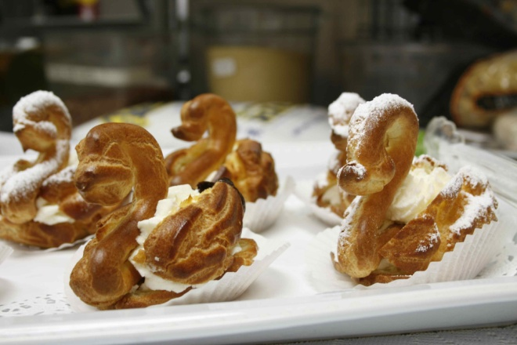
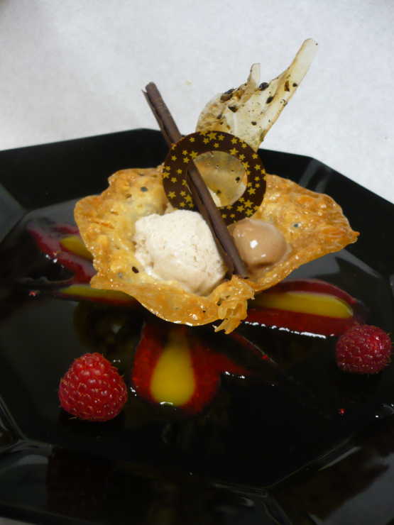
For both Culinary and Pastry with approximate prices
Digital Thermometer- $18
Stainless Steel Measuring Spoons -$5
Peeler, Smooth Blade-$8
Six-inch Metal Pocket Ruler - $2
(available at Lowes or Home Depot)
Hair Nets- $0.25
Beard Guards- $0.05

Slide 26
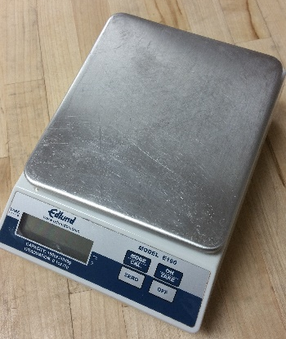
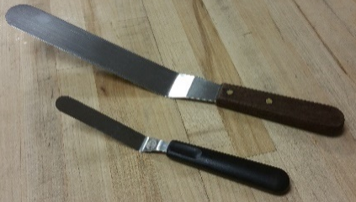
Required Culinary / Pastry Tools :
1. Digital Scale (oz/grams)-
(Must have11 lb capacity & NSF label)
Offset spatula large and small (Pastry)
3. Micro plane for zesting citrus

Slide 27
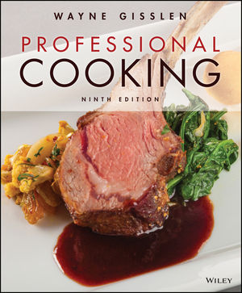
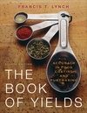
3. Textbooks for 1st Classes
PASTRY ARTS PSTR 1301
CULINARYARTS CHEF 1301
On Baking
Labensky, Martel, Van Damme, 4th Ed. $166.99
$80.99 fee semester rental, return
$86.00 additional fee to own, don't return
Professional Cooking: $162.50 (Used in 3 classes)
Wayne Gisslen:, 2018, 9th Ed.
The Book of Yields:
$55.00
Francis T. Lynch, 2010, 8th Ed.

Slide 28
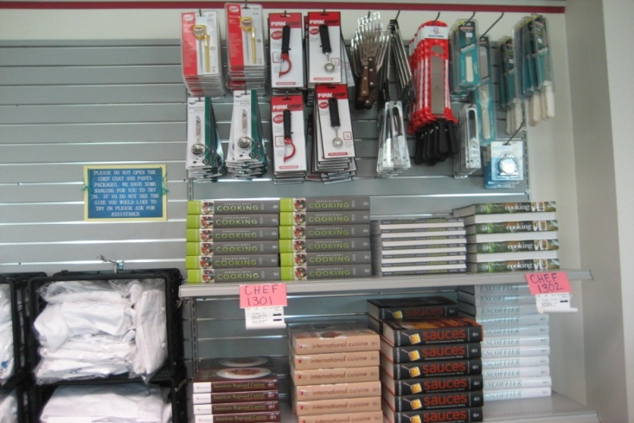
Required uniform items, knife, tool kits and books are available at Frisco Campus Bookstore Other tool sources: ACEMART 10% off with student ID (Note: All kitchen equipment must have NSF and/or CE designation for commercial use)

Slide 29
Kitchen Protocol
Full uniform must be worn in the Culinary Arts and Pastry Kitchens. Students are not permitted to enter lab class without full uniform (ACF & Frisco Health Code standards).
If you are "out of uniform" and sent out of class, you can return to class once your uniform is complete with lab points deduction for improper mise en place & lateness.
Uniform must be clean and wrinkle-free. It is advisable to bring an extra apron to class.
Fingernails must be clean and short. No nail polish or fake nails.
Jewelry is limited to a metal wedding band. DO NOT wear anything on hands & wrists.
No earrings or facial piercings allowed in the kitchen labs.
Any visible facial hair must be contained within a beard guard purchased at student's expense.

Slide 30
Kitchen Protocol continued
Your hair should not touch your collar. Hair must be contained and/or restrained. Hairnets are worn for hair that cannot be contained within a hat.
No chewing gum, drinking or eating, other than taste-testing, is permitted inside the Kitchen Labs.
No cell phone usage in the culinary lab kitchens, as per of Frisco Health Department
No food shall leave the Institute for Hospitality & Culinary Arts facility without Instructor approval
No personal effects in the kitchen, book bags, purses, coats etc.
Lockers are provided next to labs. Students need to bring their own locks for their lockers. Lockers must be vacated daily.

Slide 31
Kitchen Protocol continued
Attendance is extremely important! All classes build off the previous class and prior course skills & knowledge.
Three absences result in a final grade of “F”.
Classes cannot be made up!
Two late arrivals or departures equal one absence.
If you are not present for class, you can receive a grade of zero for that lab session. Partial credit may be granted for pre-lab submissions in CANVAS.
Each student is graded daily on the five following categories:
Proper use of tools, knives, and equipment
Mise-en-place / class preparedness
Presentation of finished product
Sanitation (start to finish)
Class participation and personal responsibility

Slide 32
Grade Standards
CHEF 1305 Sanitation & Safety
A minimum grade of “C” to pass course.
Note: A valid ServSafe Food Protection Manager certificate is collected in CHEF1341 and PSTR1310
PSTR1301 Fundamentals of Baking
A minimum grade of “C” to pass course and move onto next level pastry classes
CHEF 1301 Basic Food Preparation
A minimum grade of “C” to pass course and move onto Chef 2331 and Chef 2302
CHEF 2331 Advanced Food Preparation
A minimum grade of "C" to pass course and move onto next level Culinary classes.

Slide 33
Suggested Degree Course Sequence
Level 1 Culinary Certificate | Classes in blue are suggested to be included in your first semester as a full-time student
CHEF 1305 | Safety & Sanitation, 8-week Express
CHEF 1301 | Basic Food Preparation, 8-week Express
CHEF 2331 | Advanced Food Preparation, 8-week Express
IFWA 1310 | Nutrition and Menu Planning, 16-week
PSTR 1301 | Fundamentals of Baking, 8-week Express
CHEF 2302 | Saucier, 8-week Express
CHEF 1341 | American Regional Cuisine, 8-week Express
CHEF 1310 | Garde Manger, 8-week Express (Level 1 Cert. Capstone)

Slide 34
Suggested Degree Course Sequence
AAS Culinary | Classes in Blue Suggested in First Semester as Full Time Student
CHEF 1305 | Safety & Sanitation, 8 week Express
CHEF 1301 | Basic Food Preparation, 8 week Express
HAMG 1321 | Introduction to Hospitality, 8 week Express
CHEF 2331 | Advanced Food Preparation, 8 week Express
IFWA 1310 | Nutrition and Menu Planning, 16 week
CHEF 2302 | Saucier, 8 week Express (concurrent or after CHEF2331)
PSTR1301 | Fundamental of Baking, 8 week Express
CHEF 1341 | American Regional Cuisine, 8 week Express
RSTO 1325 | Purchasing, 16 week
CHEF 1310 | Garde Manger, 8 week Express
CHEF 1345 | International Cuisine, 8 week Express
HAMG 1324 | Hospitality Human Resources, 16 week
CHEF 2380 | Culinary Co-op, 16 week
CHEF 1314/RSTO 1304 | (AAS Capstone) A La Carte/Dining Room Service, 16 week
Note: Does not include AAS General Education (Gen. Ed.)
Core classes. Gen. Ed. classes are scheduled as needed.

Slide 35
Suggested Degree Course Sequence
Cert. 1 Pastry | Classes in Blue Suggested in First Semester as Full Time Student
CHEF 1305 | Safety and Sanitation, 8-week express
PSTR 1301 | Fundamentals of Baking, 8-week express
PSTR 2301 | Chocolates & Confections, 8-week express
CHEF 1301 | Basic Food Preparation, 8-week express
IFWA 1310 | Nutrition and Menu Planning, 16-week
PSTR 1305 | Breads & Rolls, 8-week express
PSTR 1306 | Cake I, 8-week express
PSTR 1310 | Pies, Tarts, & Teacakes, 8-week express
Note: Does not include AAS General Education (Gen. Ed)
Core classes. Gen. Ed. classes may be scheduled as needed.

Slide 36
Suggested Degree Course Sequence
AAS Pastry | Classes in Blue Suggested in First Semester as Full Time Student
PSTR 1301 | Fundamentals of Baking, 8 week express
CHEF 1305 | Safety and Sanitation, 8 week express
CHEF 1301 | Basic Food Preparation, 8 week express
HAMG 1321 | Introduction to Hospitality, 8 week express
PSTR 2301 | Chocolates & Confections, 8 week express
HAMG 1324 | Hospitality Human Resources, 16 week
IFWA 1310 | Nutrition and Menu Planning, 16 week
PSTR 1305 | Breads & Rolls, 8 week express
RSTO 1325 | Purchasing, 16 week
PSTR 1306 | Cake I, 8 week express
PSTR 1310 | Pies, Tarts, & Teacakes, 8 week express
PSTR 2307 | Cake Decorating II, 8 week express
PSTR 2380 | CO-OP, 16 week
PSTR 1312 | Laminated Dough, Pate a Choux, and Donuts, 8 week Express
PSTR 2331 | (Capstone) Advanced Pastry, 8 week express
Note: Does not include AAS General Education (Gen. Ed)
Core classes. Gen. Ed. classes may be scheduled as needed.

Slide 37
Communications
CougarWeb
CougarMail
Facebook: https://www.facebook.com/collincollegepastry/
Instagram: https://www.instagram.com/collincollegepastry/

Slide 38
Culinary/Pastry Student Organization
"The Culinary Club" :a Student run organization
Enrich your college experience!!!
Get involved - become an officer or member
The students drive the activities with funds requested from Collin College
It’s absolutely free!

Slide 39
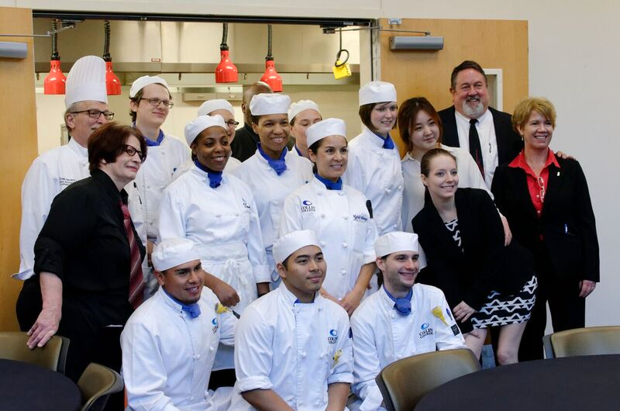
Thank you for coming to our Culinary & Pastry Student Orientation! Now for the Tour!
ANY QUESTIONS??

